Slide 1
INTERNAL USE ONLY
February 2024
Best Practices for AVEVA System Platform 2023 R2
Michael Brost

Slide 2

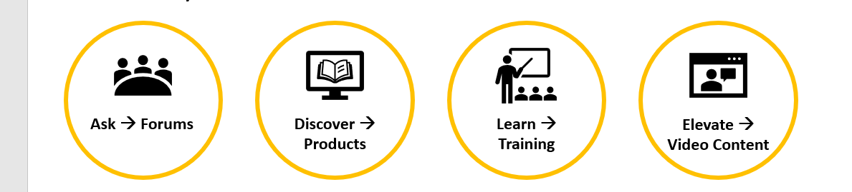
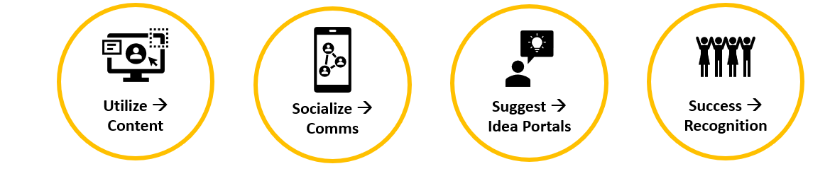
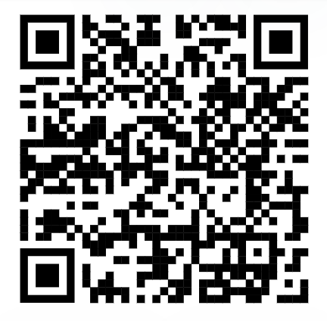
IS HERE!
https://softwareforums.aveva.com/heroes-hq
Join the HMI / SCADA technical community today!

Slide 3
Network Architecture
Security
Team Development Practices
Redundancy

Slide 4
Network Architecture

Slide 5
Architecture of our Class Network
Production Galaxy and Template Storage Galaxy
Teams of Four (4) Members each
Common Project VMs
Galaxy Repository (GR)
Template
Production
RDS Server
IDE/OMI Desktop Session
OMI Web Server (//RDS/OMI)
Certificate Management (SMS)
Active Directory
HIST1 and HIST2
Discovery Services
License Management
Historian
System Platform Runtime
Communication Servers

Slide 6
Architecture of our Class Network
Individual Development Galaxy
Development GR
DevTest Galaxy
Local Platform
Dev App Engine
Local Development Historian
Communication Server
Paired with Main GR
IDE Connected to Template on GR
IDE Connected to DevTest Locally

Slide 7
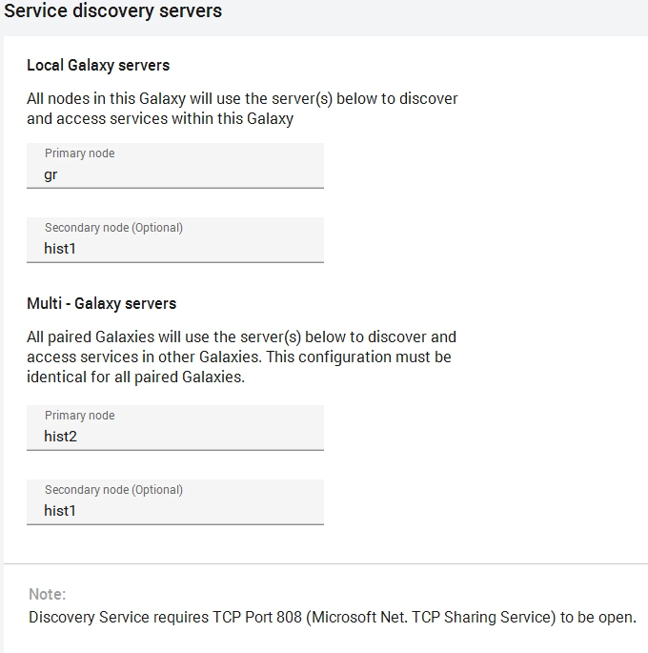
Configure Service Discovery Servers
Platform Common Services (PCS) Discovery
Main Galaxy Repository (GR)
Local Discovery Service
Part or Platform Deployment Package
Not Configurable
Local Galaxy Discovery Service
Primary Defaults to Galaxy Repository node
Assign Secondary to Runtime Node
Multi - Galaxy Discovery Service
Common to all Galaxies in a multi-galaxy scenario
Primary and Secondary Service locations
HIST2 (Pri) and HIST1 (Sec)
Needs to be accessible from all galaxies

Slide 8
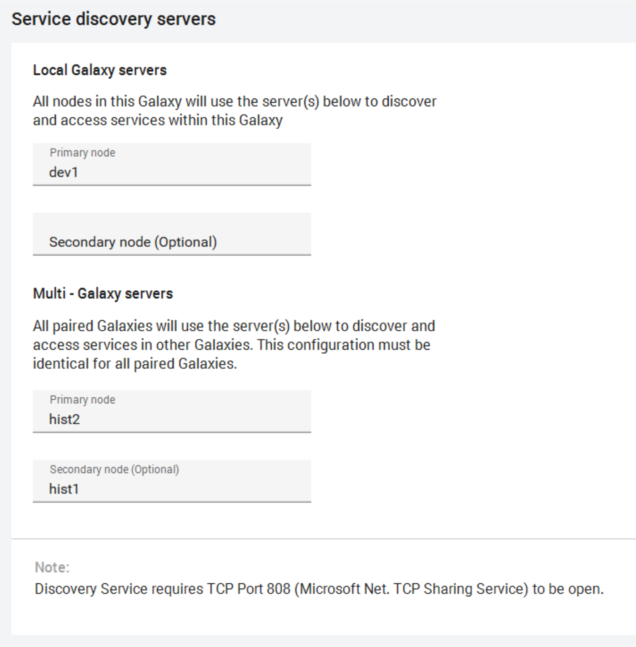
Configure Service Discovery Servers
Platform Common Services (PCS) Discovery
Development Galaxy Repository (DEVn)
Local Discovery Service
Part or Platform Deployment Package
Not Configurable
Local Galaxy Discovery Service
Primary Defaults to DEVn node
Multi - Galaxy Discovery Service
Common to all Galaxies in a multi-galaxy scenario
Primary and Secondary Service locations
HIST2 (Pri) and HIST1 (Sec)
Needs to be accessible from all galaxies

Slide 9
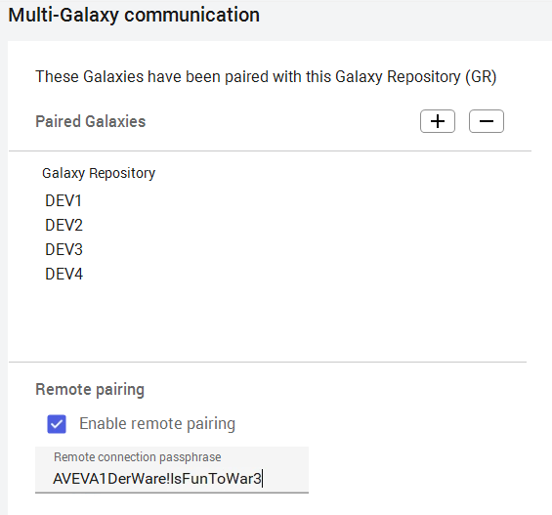
Pairing of Galaxy Repositories
IDE/GR Installed on an OS most be Paired to another IDE/GR Install
A passphrase must be created to enable pairing
Mininum 9 Characters
Must have one of each
UPPERCASE
Lowercase
Number
Symbol !@#$%^&*()
Passphrase must be the same on both nodes of the pair
Every Galaxy must have a unique name
Multiple Galaxies can reside in a single Repository
Only one Galaxy can be deployed from a single Repository
All Galaxies must point to a common set of Multi-Galaxy Discovery Servers
All Galaxies on same Repository share paring setup

Slide 10
Security With Multiple Galaxies

Slide 11
Configuration of Security
Security is modeled in the Galaxy Repository
Security is based on a hierarchy of configurations
User is authorized from Authentication Provider
Roles are assigned to user
Assigned in Authentication Provider
Domain Groups are Imported as Roles
Roles are allocated permissions in Security Model
General Permissions
IDE Permissions
Importing and Exporting
Platforms, Engines, Areas, DIOs, AppObjects
Create/Modify/Delete Templates or Instances
Security Modifications
Graphics Management Permissions
Alarm Management Strategy
OCMC Permissions
Security groups
Contain Objects
Only Instances have relevance
Runtime Permissions for Objects in Group by Role
Alarms
Can Acknowledge Alarms
Can Shelve Alarms\
Can Modify Alarm Modes
Can Modify Plant States
Can Modify “Configure” Attributes
Can Modify “Operate” Attributes
Can Modify “Tune” Attributes
Can Verify Writes

Slide 12
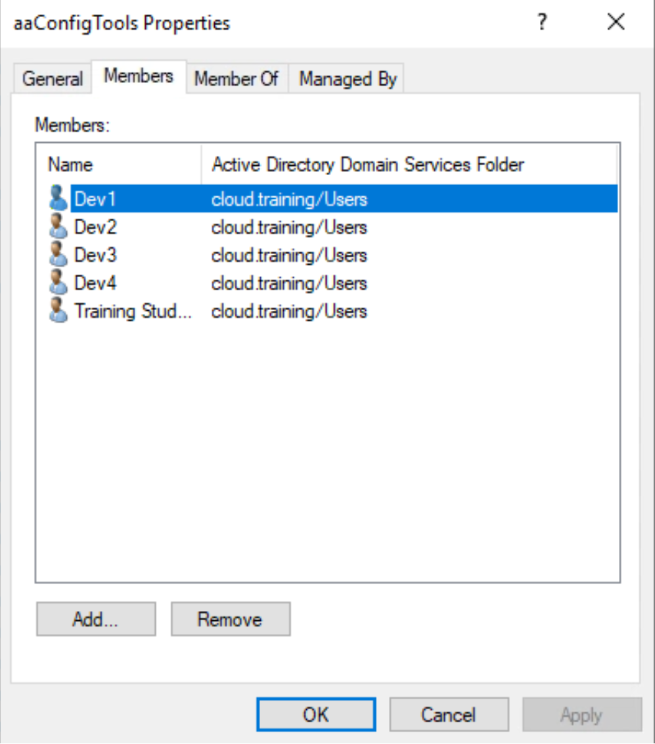
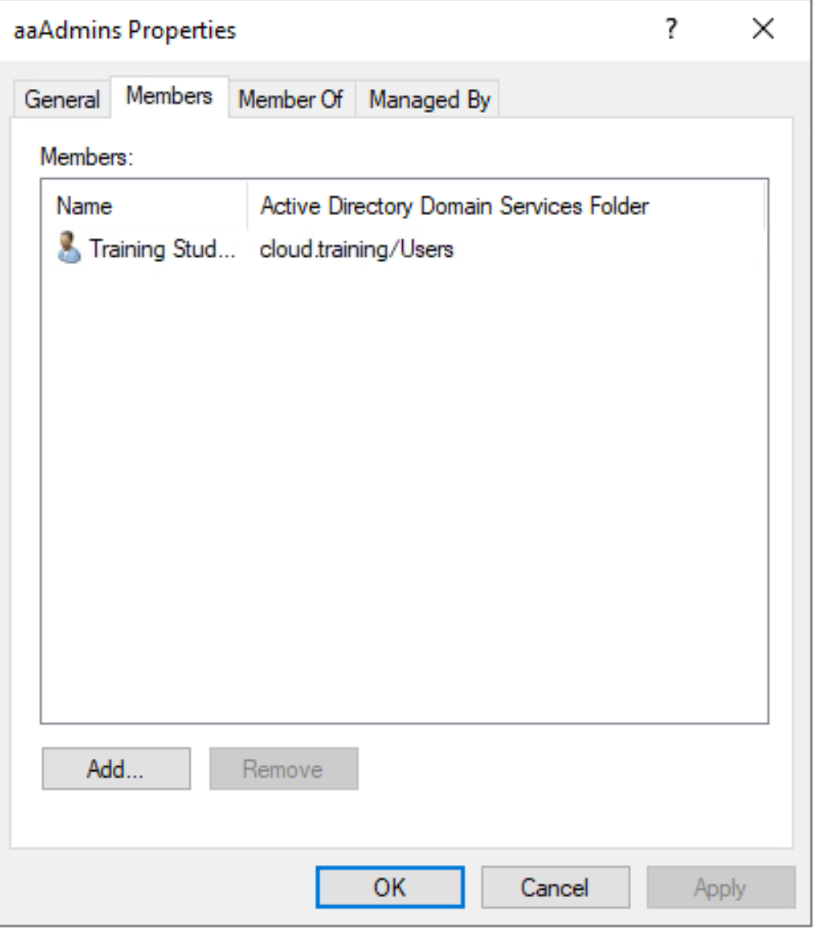
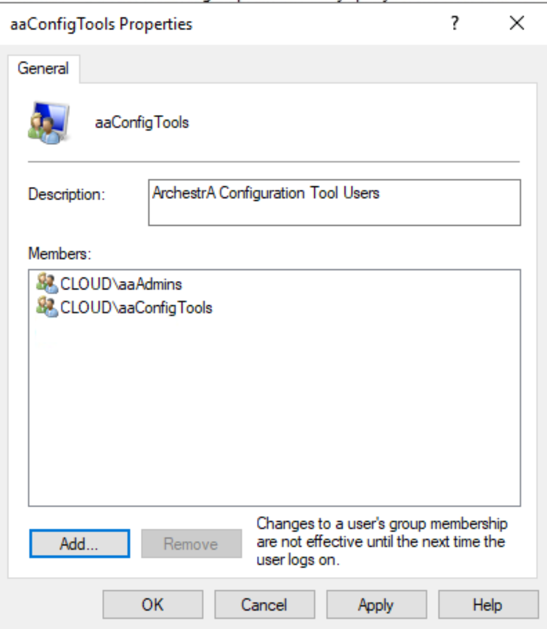
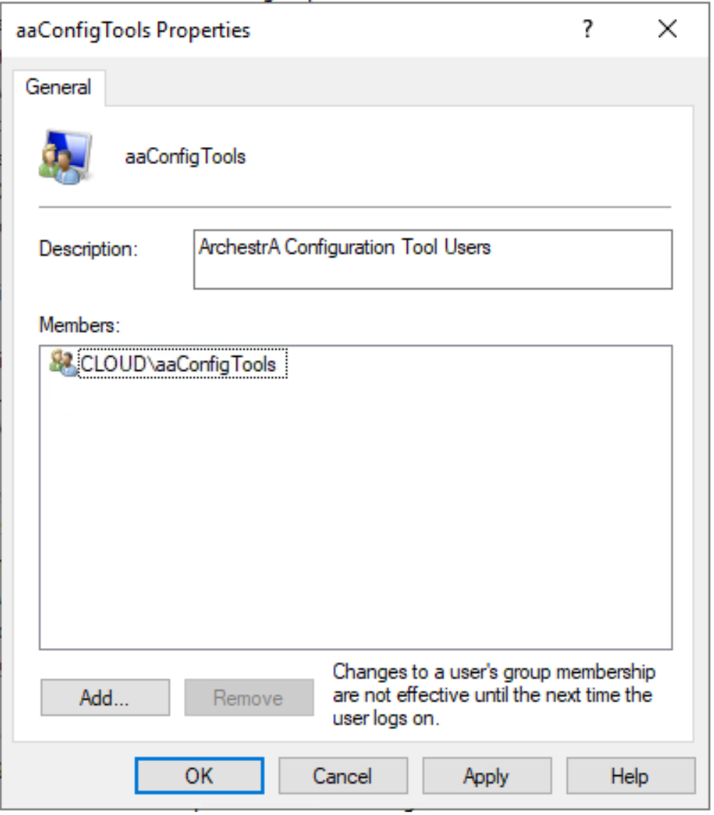
Multi Developer Security
ADS
Domain Group for Developers
CLOUD\aaConfigTools
CLOUD\aaAdmins
GR
aaConfigTools
Includes CLOUD\aaDevTools
Includes CLOUD\aaAdmins
DEVn
aaConfigTools
Includes CLOUD\aaDevTools

Slide 13
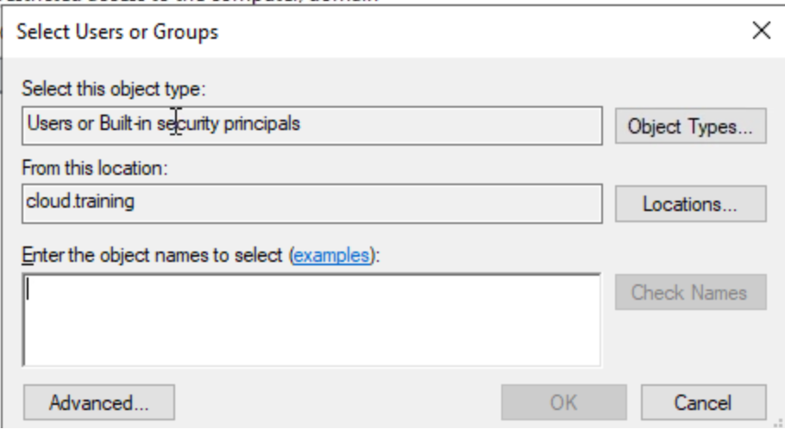
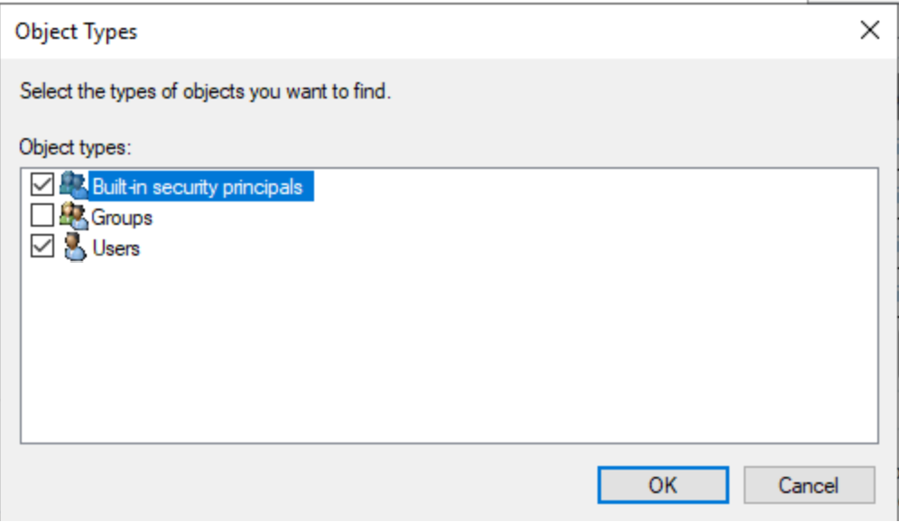
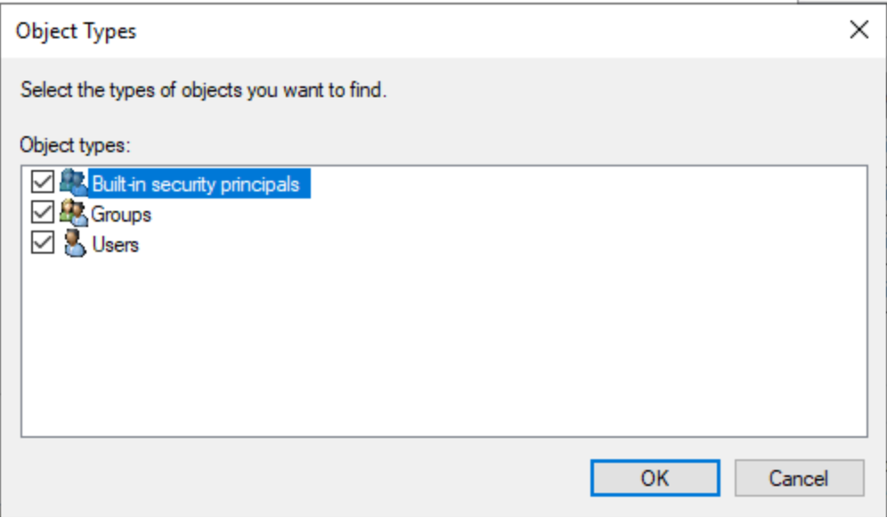
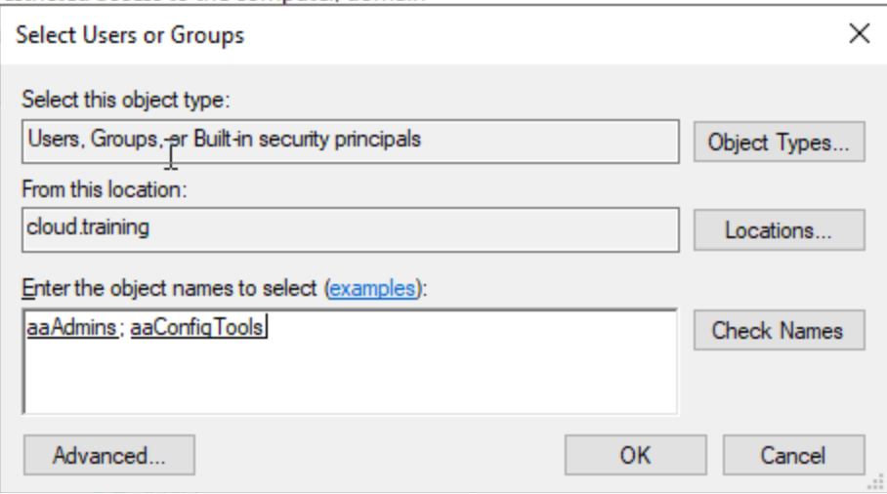
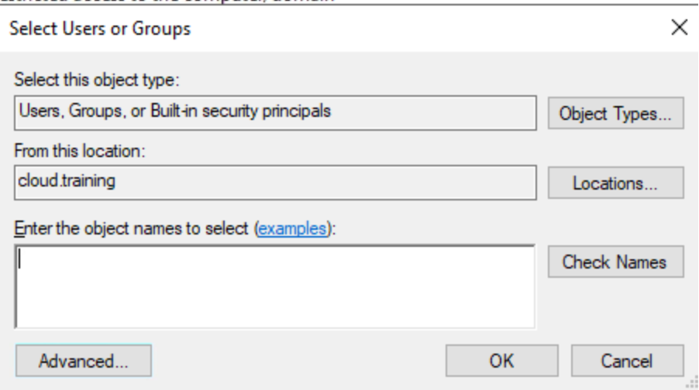
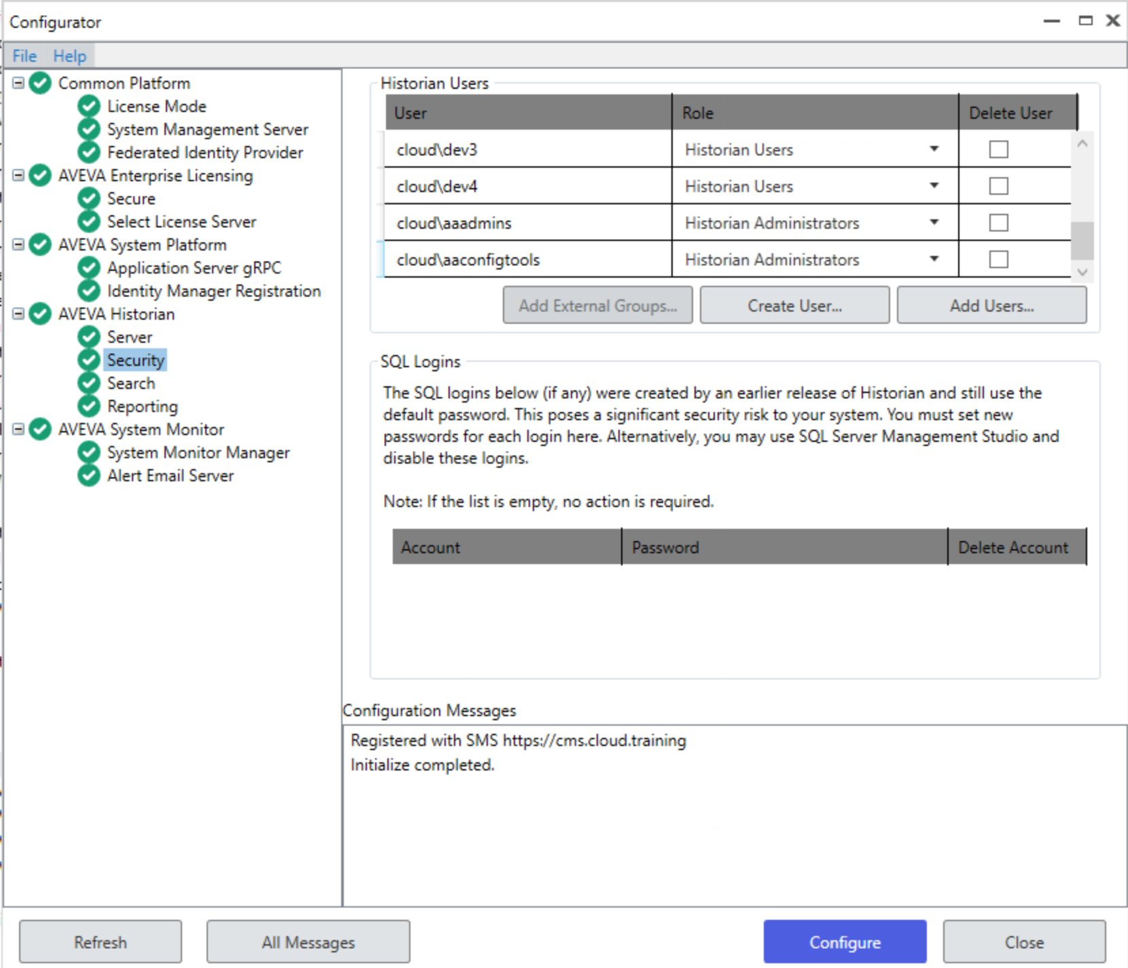
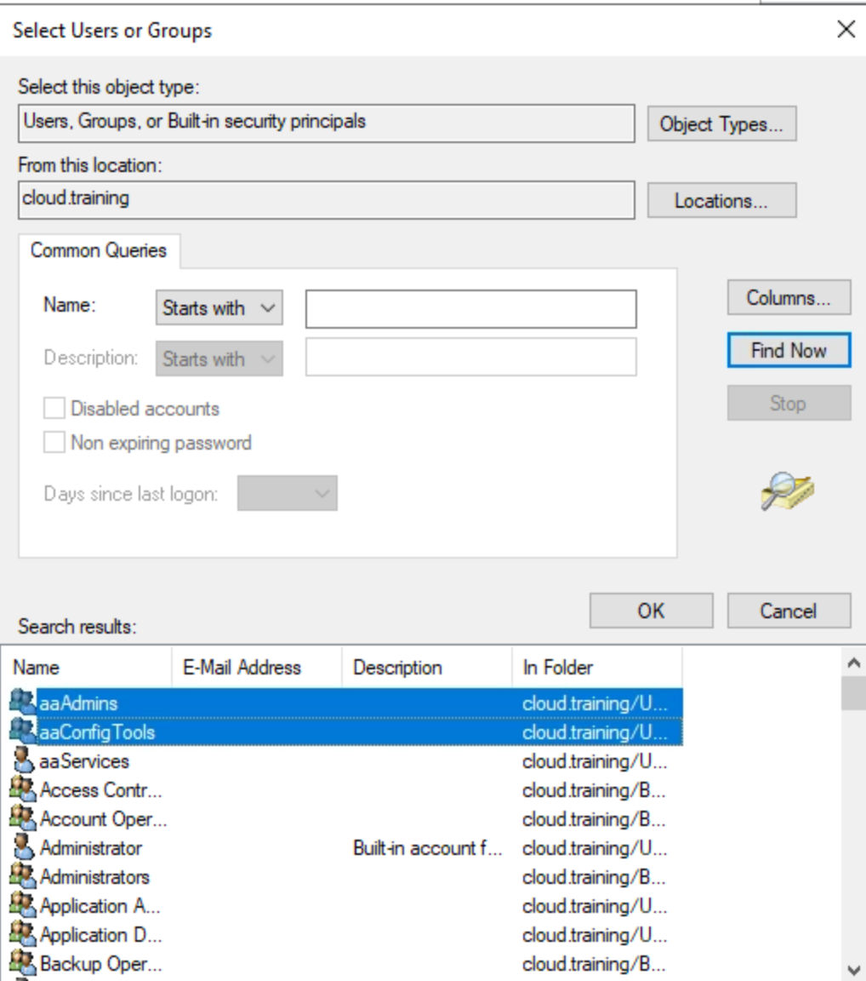
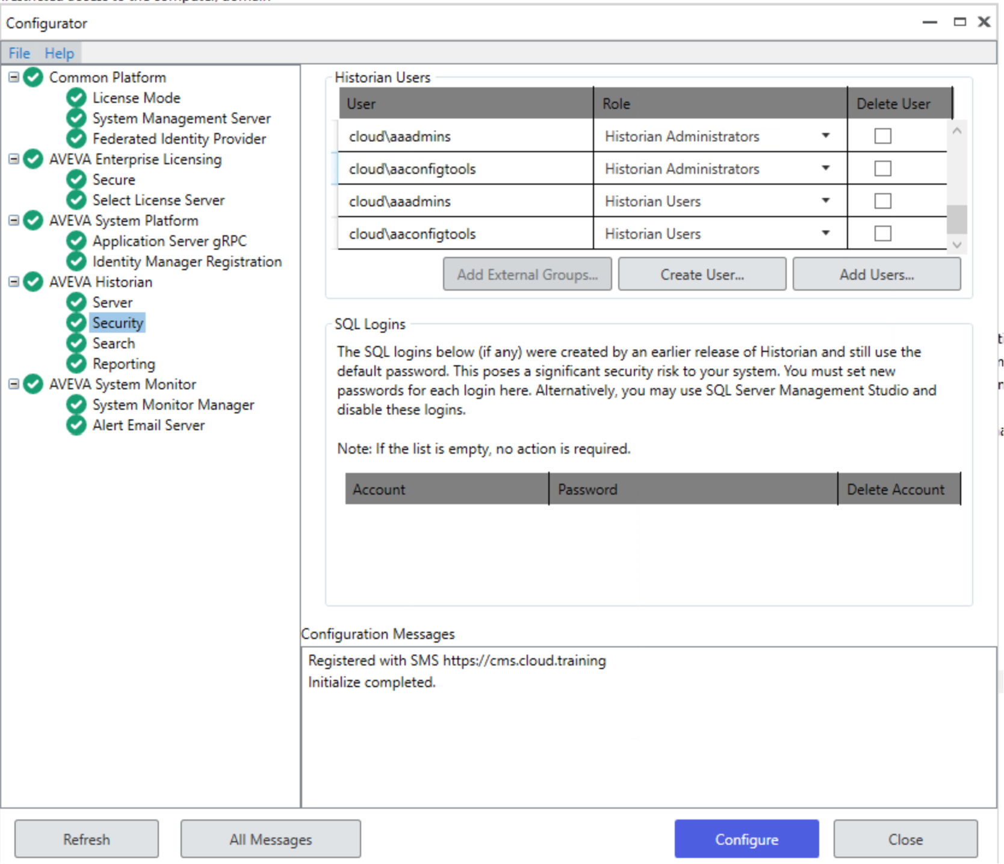
Historian Configuration
Historian Local Groups
aaAdministrators
aaPowerUsers
aaUsers
MS SQL Server
Historian Administrators
SysAdmin Role
AVEVA -> Configurator
AVEVA Historian
Security Section – Add Users…
Object Type – Enable Groups
Advanced… -> Find Now
Select the Domain Groups to add

Slide 14
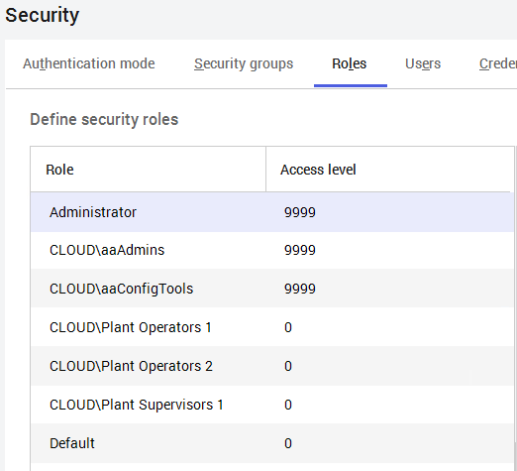
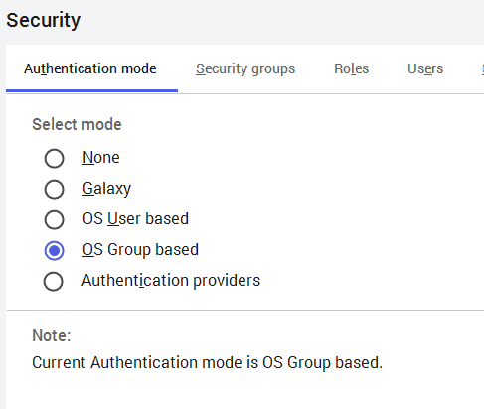
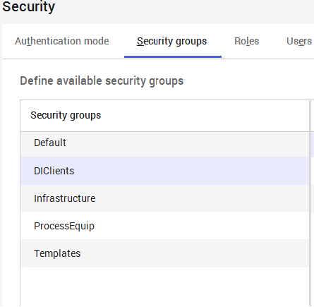
Security Configuration and Modeling
Production Galaxy
Authentication mode: OS Group based
Security Groups
DIClients
DIOs
Templates (place to put templates)
Infrastructure
Platforms, Engines, Areas,
ProcessEquip
Plant Assets
Roles Imported from Active Directory (Examples)
CLOUD\aaAdmins
CLOUD\aaConfigTools
CLOUD\Plant Operators 1
CLOUD\Plant Operators 2
CLOUD\Plant Supervisors 1
Suggested Role configuration in General
CLOUD\aaAdmins
All General Permissions
All Operations Permissions
CLOUD\aaConfigTools
General Permissions
Minimum Permissions
All Operational Permissions
CLOUD\Plant Operators 1 & 2
Very Limited General Permissions
Operational Permissions
Limited to Security Groups Responsible for
Cannot Verify
CLOUD\Plant Supervisors 1
Basic General Permissions
Operations Permissions
Can Verify

Slide 15
Security Configuration and Modeling
Template Galaxy
Security Groups
Templates (place to put templates)
Infrastructure
Platforms, Engines, Areas, DIOs
ProcessEquip
Plant Assets
Roles Imported from Active Directory (Examples)
CLOUD\aaConfigTools
CLOUD\aaAdmins
Suggested Role configuration in General
CLOUD\aaConfigTools
General Permissions
Inporting and Exporting
Remove Runtime Permissions
Operational Permissions
Limited

Slide 16
Security Configuration and Modeling
DevTest Galaxy
Roles Imported from Active Directory (Examples)
CLOUD\aaConfigTools
Security Groups
Templates (place to put templates)
Infrastructure
Platforms, Engines, Areas, DIOs
ProcessEquip
Plant Assets
Suggested Role configuration in General
CLOUD\aaConfigTools
General Permissions
Full
Operational Permissions
Full

Slide 17
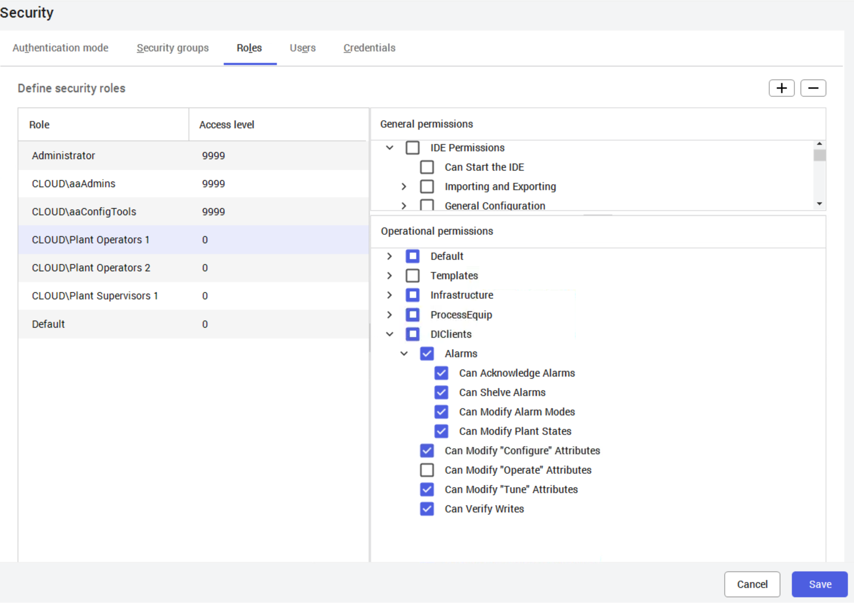
Configuration of Security
Device Integration Objects
Client Objects for Access to OI Servers
DDESuitelinkClient
OPCClient
Creates a connection to an external OI Server
One DI Client per OI Server Instance
Multiple Scan Groups can be configured
Avoid placing on a redundant AppEngine
All Attributes are accessible with the Operate Permission on the Security Group.
Attributes can be Dynamically Added at Runtime
Place all DI Client objects in a Security Group
Deny Operate Permission to Operator Roles

Slide 18
Working with the System

Slide 19
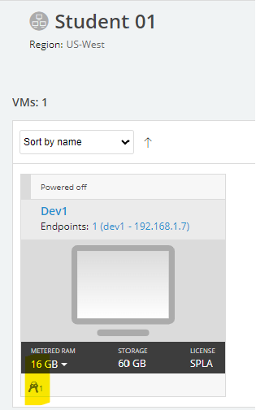
Log on to Your DEVn Workstation
Tim Brost (tim.brost@california.avevaselect.com) https://cloud.skytap.com/vms/5de9963c12cd494368fd93c692ca6a1d/desktops
Tim Brost (tim.brost@california.avevaselect.com) https://cloud.skytap.com/vms/5de9963c12cd494368fd93c692ca6a1d/desktops
Use the URL you were sent in the e-mail (Similar to as follows)
Tim Brost (tim.brost@california.avevaselect.com)
https://cloud.skytap.com/vms/5de9963c12cd494368fd93c692ca6a1d/desktops
Username: DEVn Password: ww
Credentials

Slide 20
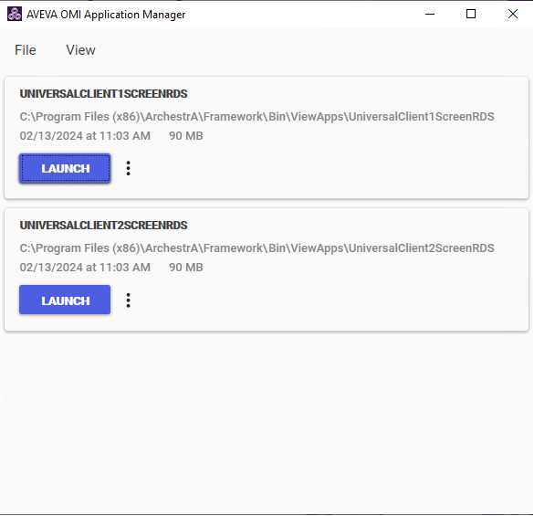
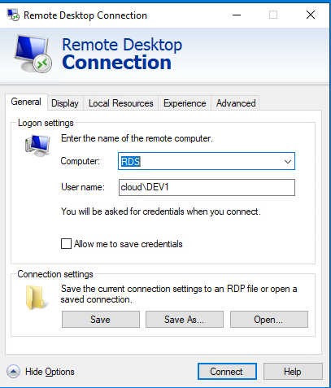
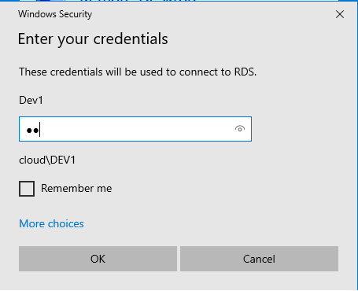
Remote Desktop Connection to RDS Node
Launch Remote Desktop Connection
Computer RDS
Username: CLOUD\Dev1
Password: ww
Launch OMI Application Manager
Select UNIVERSALCLIENT1SCREENRDS

Slide 21
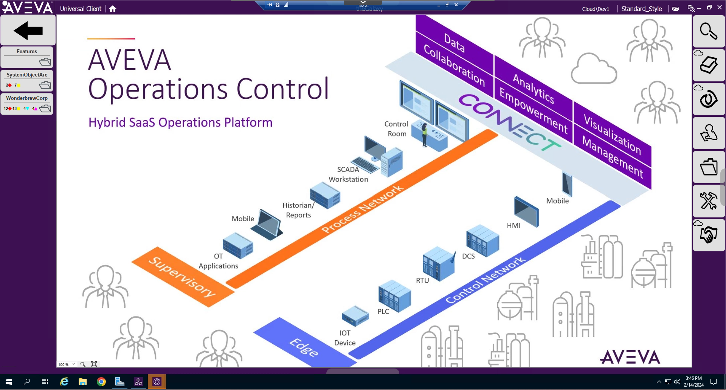

Slide 22
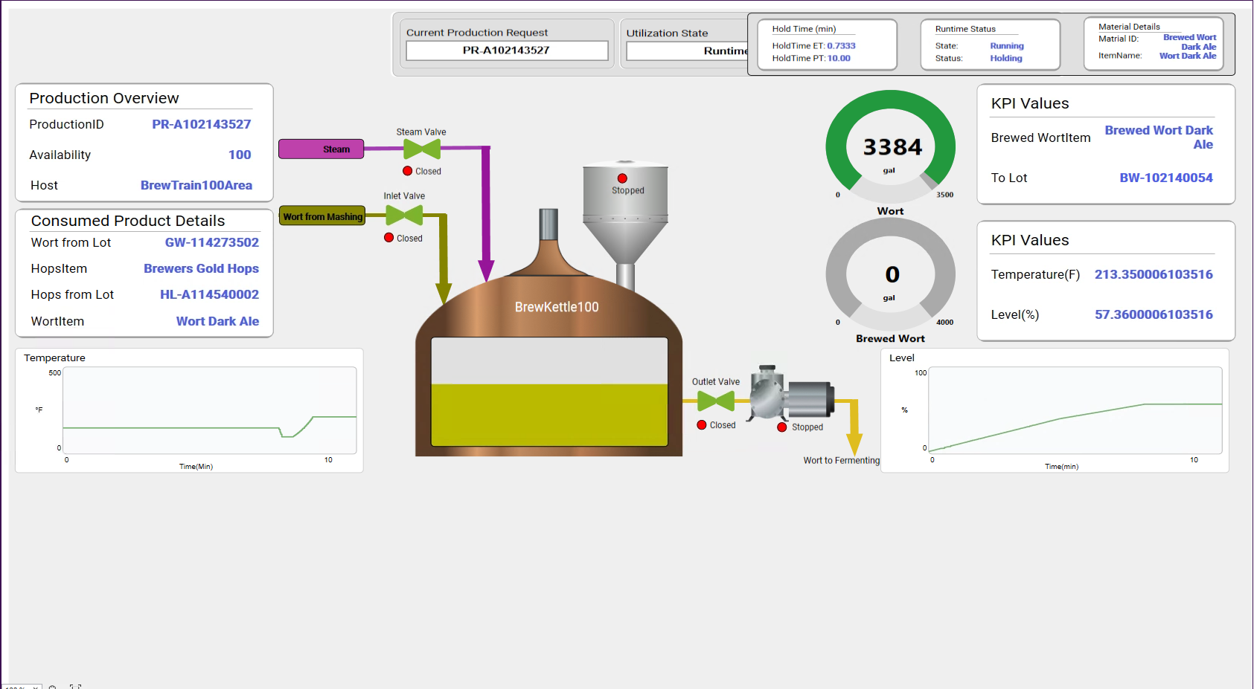
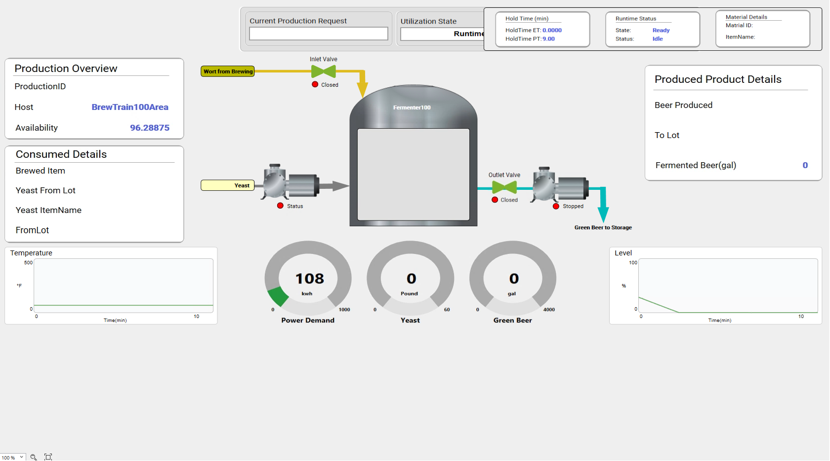
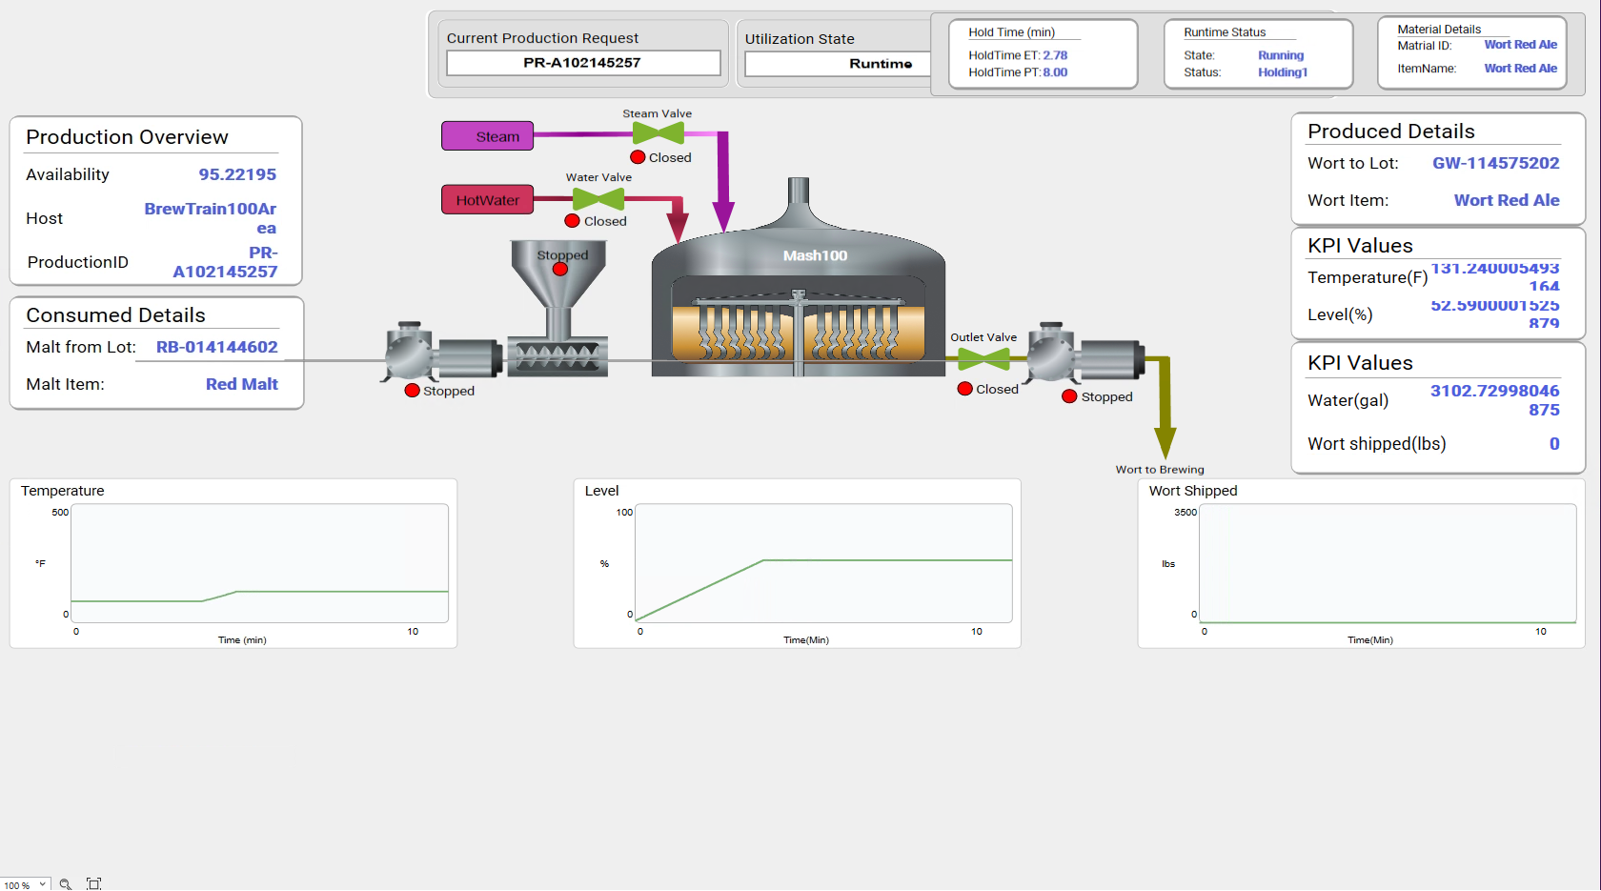
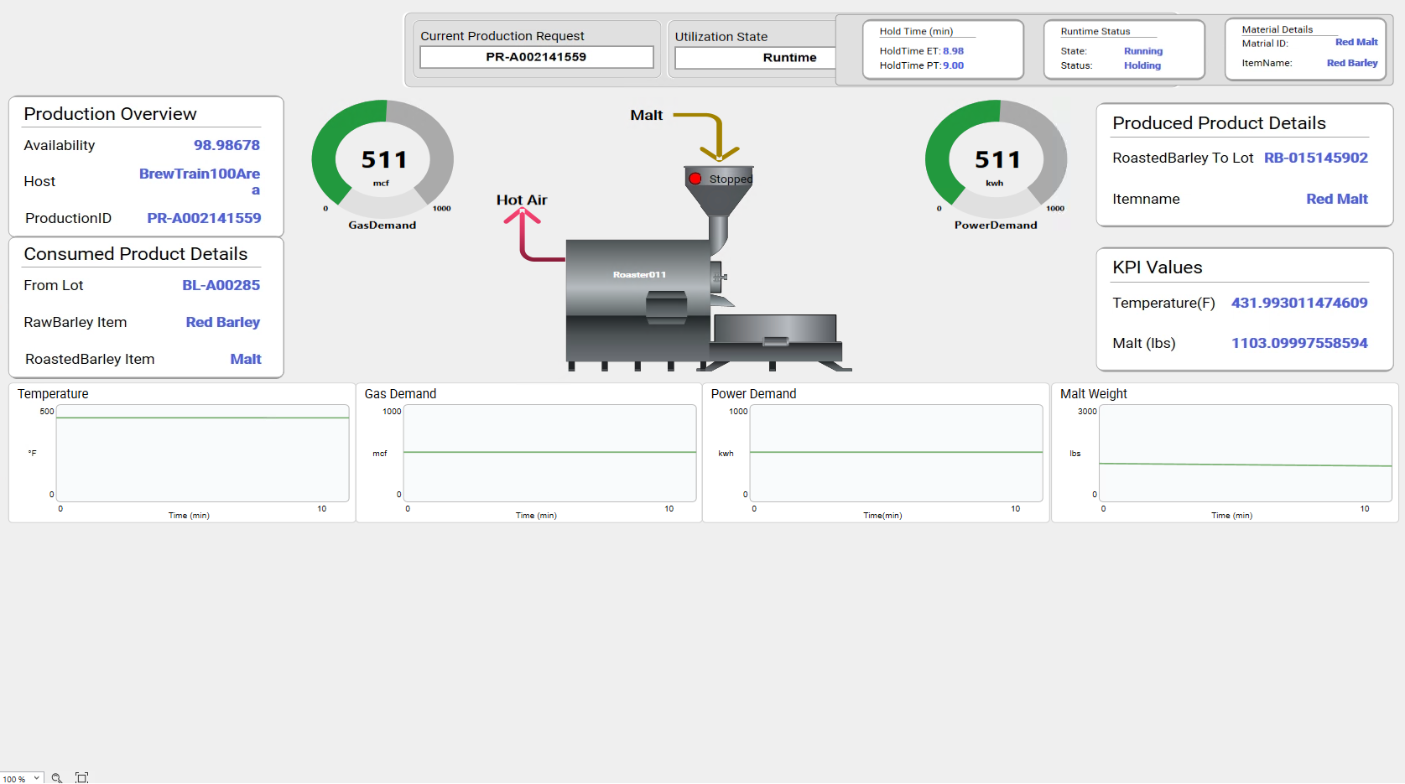
Explore the OMI App
Navigate to the BrewTrain100
WonderbrewCorp
NewYorkPlantArea
BrewTrain100Area
Select BrewKettle100
Observe the 2 Displays
Select Fermenter100
Observe the 2 Displays
Select Mash100 -> MaltMill100
Observe the 2 Displays
Select Roaster011
Observe the 2 Displays

Slide 23
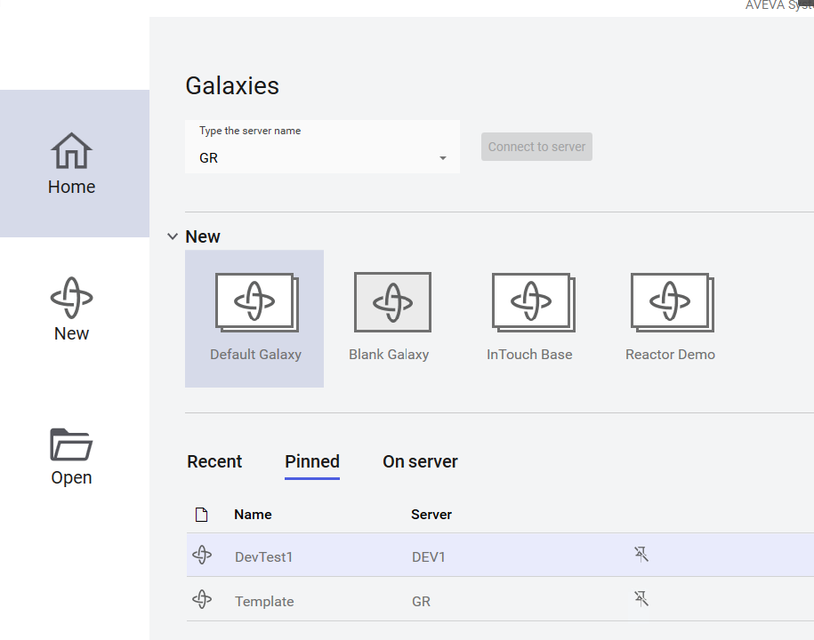
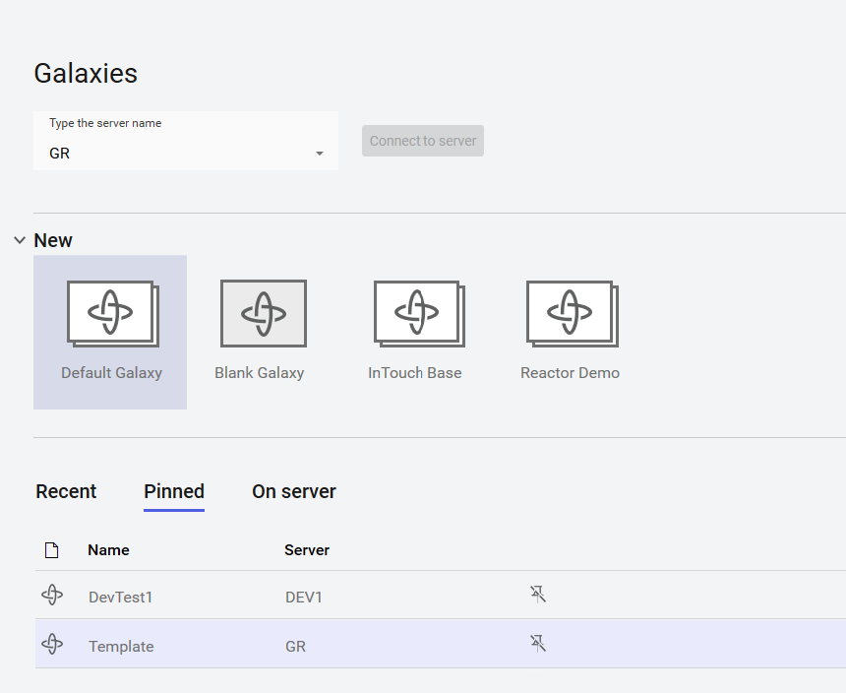
Graphics on each Asset needs to the Repaired
Production Request Graphic is out of position
Each Developer needs to Fix and Test their Asset
Close the Remote Desktop Session on Your Workstation
Launch the System Platform IDE
Connect to the Template Galaxy on the GR
Click on the Pinned Option
Launch a 2nd System Platform IDE
Connect to the DevTestn Galaxy on the DEVn Node
Click on the Pinned Option
2 IDE’s on the Desktop

Slide 24
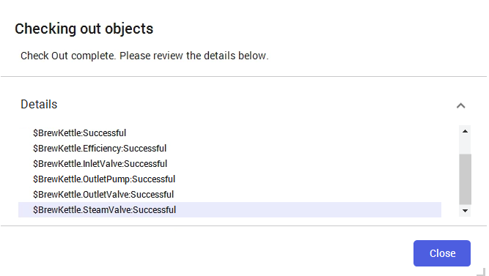
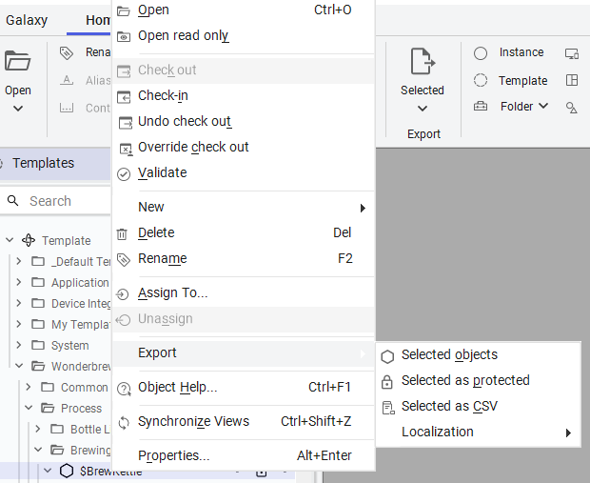
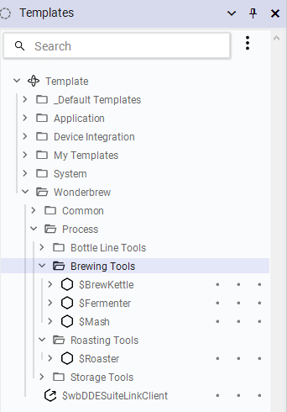
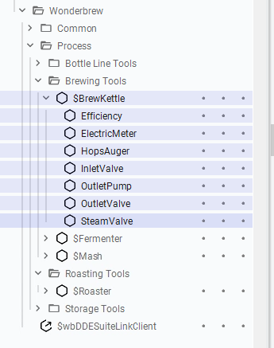
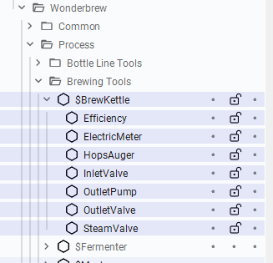
Get the Asset Template Standard from the Template Galaxy
DEV1 - $BrewKettle
DEV2 - $Fermenter
DEV3 - $Mash
DEV4 - $Roaster
Select your assigned Asset and all the Contained Templates
Checkout your Asset and Contained Assets
Your Team knows you are working on this Asset
Export your Parent Asset only into an aaPkg File
Selected Objects Option
Save the$AssetName.aaPKG to Documents Folder

Slide 25
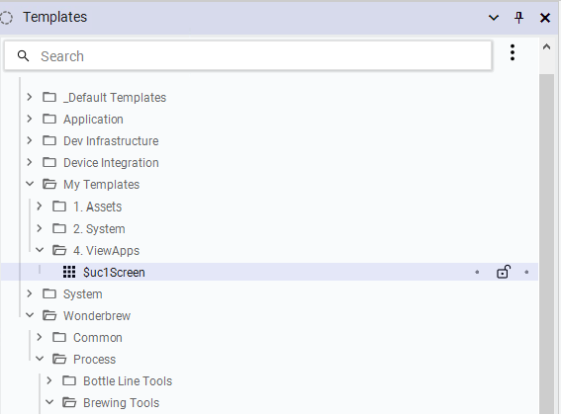
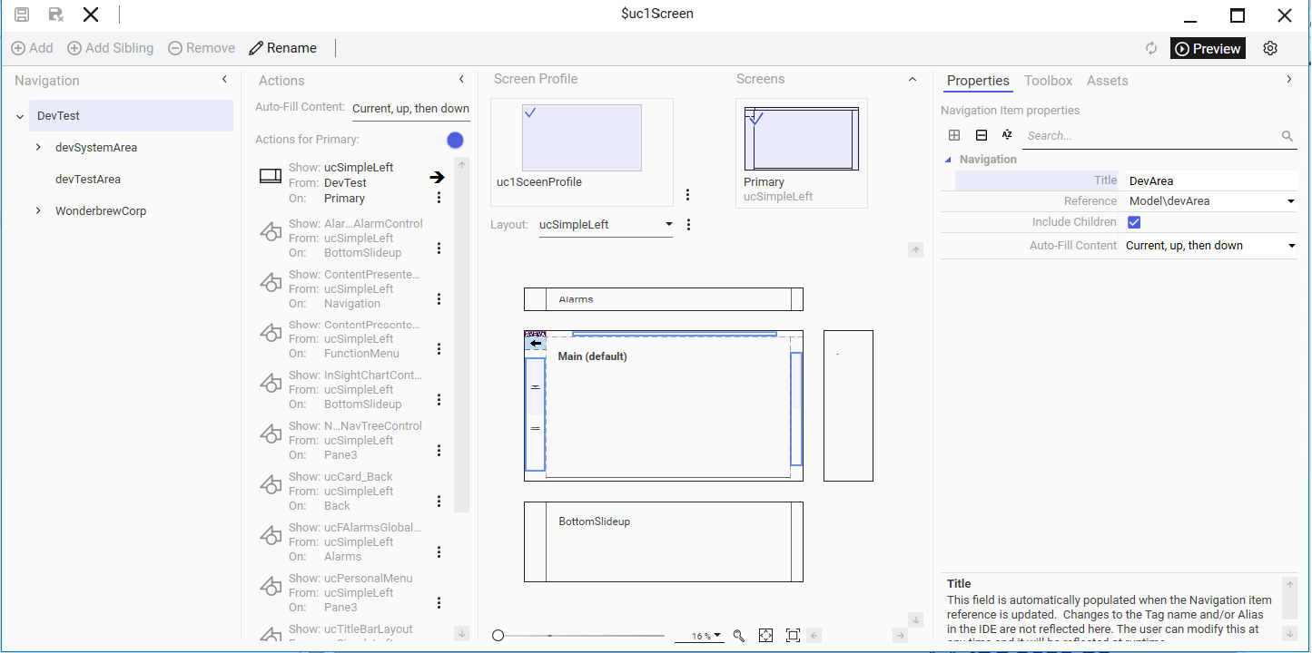
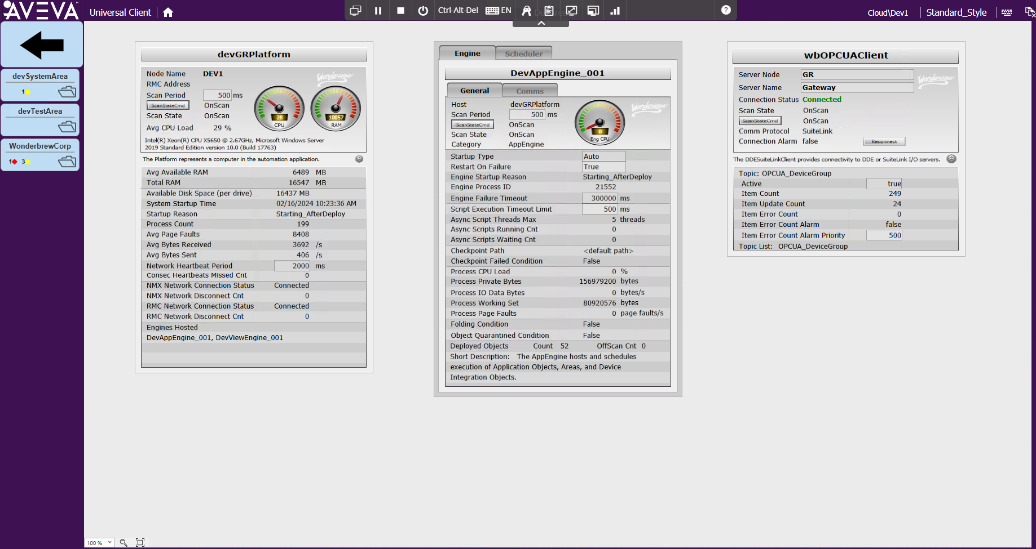
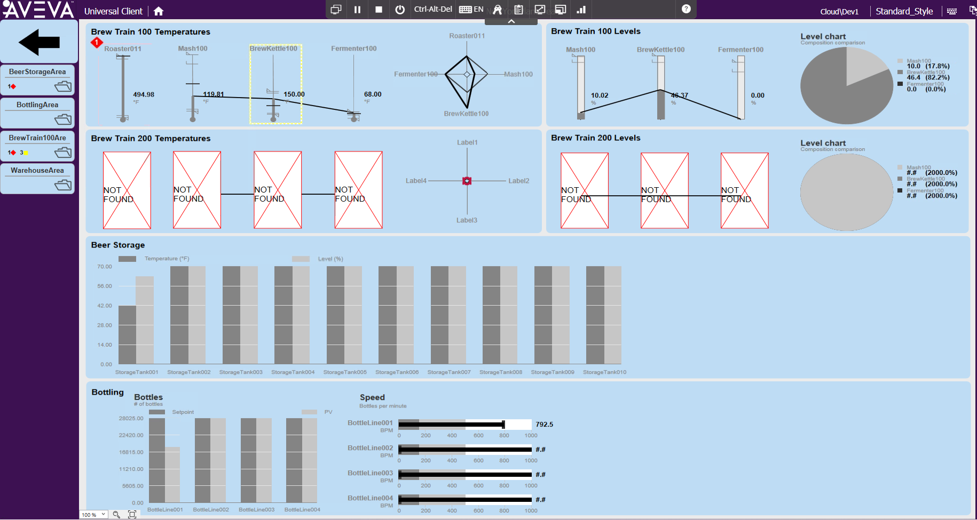
Activate the OMI App in Preview
Open the $uc1Screen OMI APP
Place the OMI App in Preview Mode
Edits to Asset and Toolset Graphics will be reflected immediately without have to deploy the OMI App
Confirm that the wbOPCUAClient is Connected devSystemArea tile
Observe that the Dev Test OMI App is showing a minimal set of assets for the purpose of testing
Some Overview Graphics will show missing Asset Content, This is expected

Slide 26
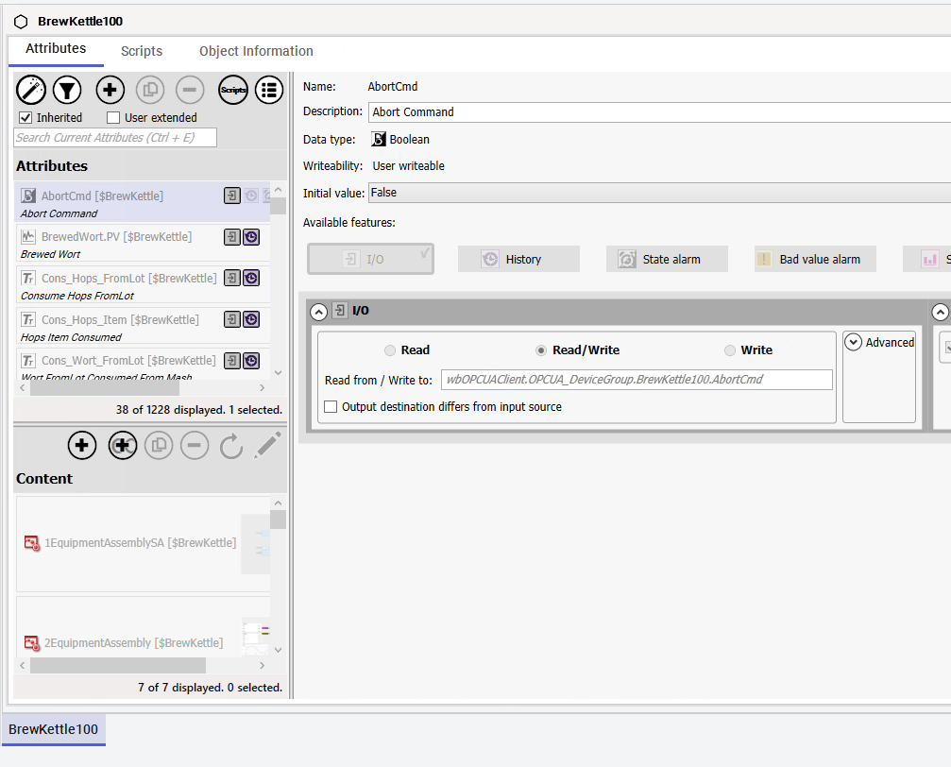
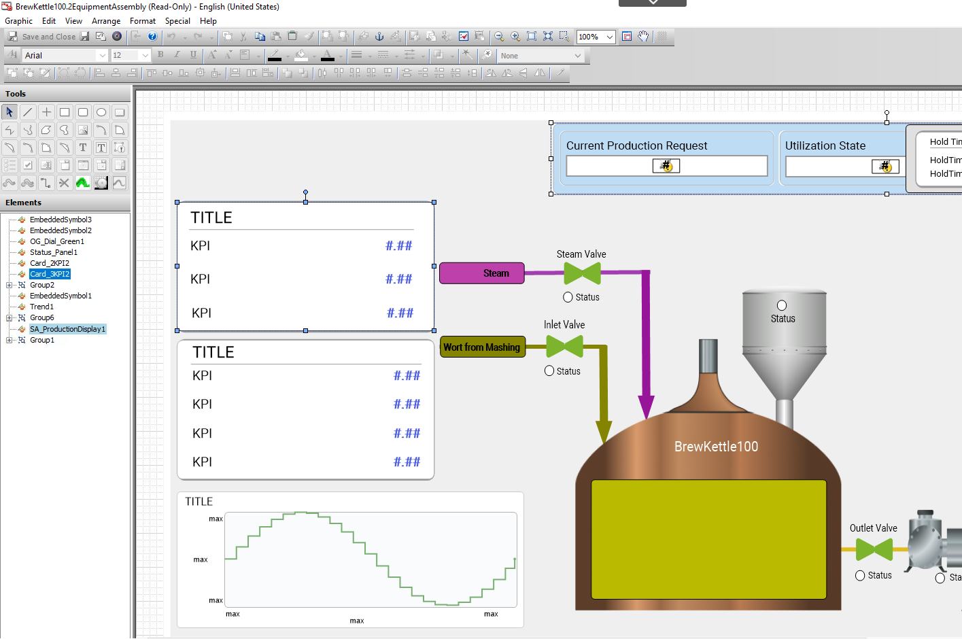
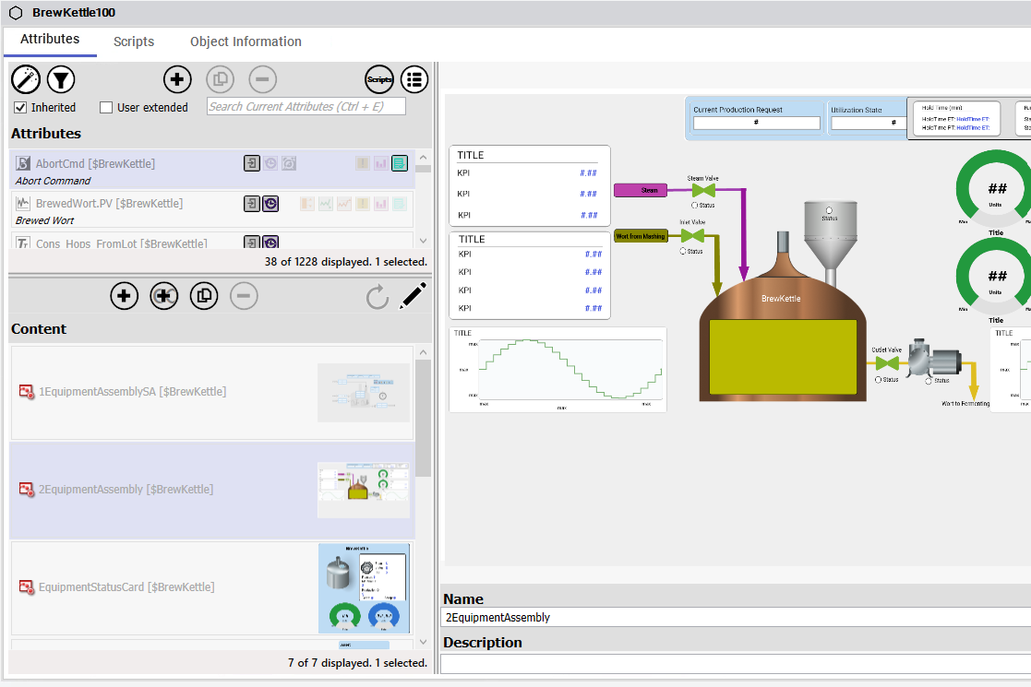
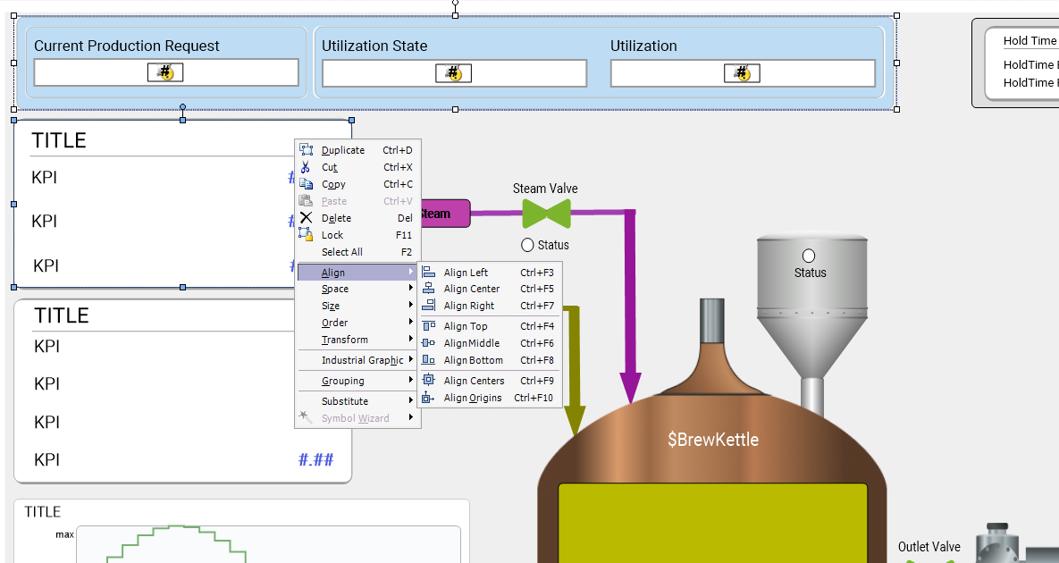
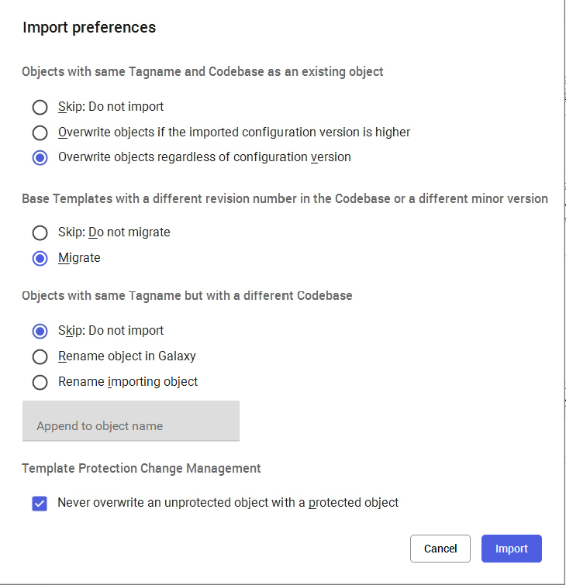
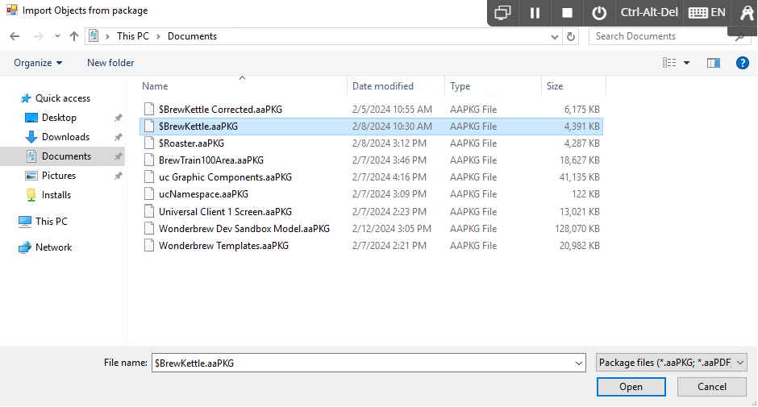
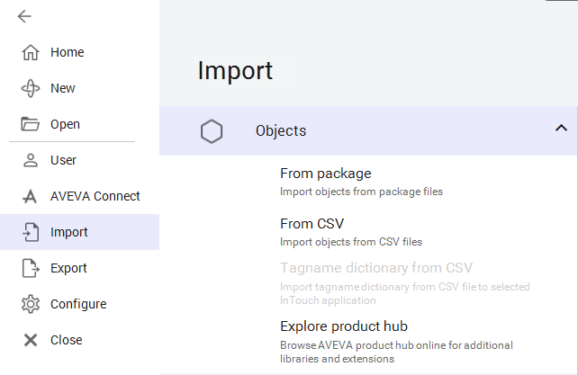
Load the Asset into your DevTestn Galaxy
Use Galaxy Backstage to Import the aaPKG file exported from the Template Galaxy
Choose to Overwrite objects regardless of version if your DevTest is of a higher version than the Template
Open your Asset from the DevTestn Galaxy
Edit the 2EquipmentAssembly Content
Select the two graphics as shown
Click on Current Production Request
Shift Click on Title Box
Right Click
Align -> Align Left
Save and Close

Slide 27
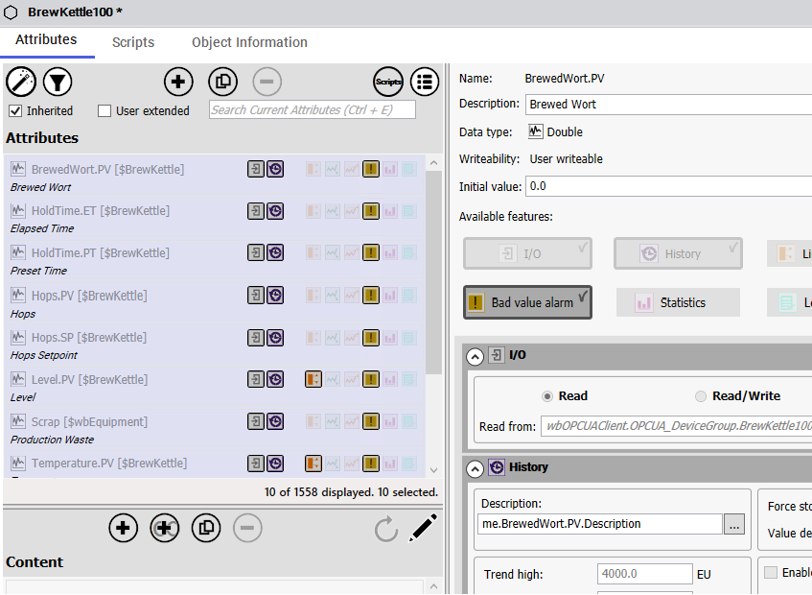


Add the Bad Value Alarm Feature to all Analog IO Attributes
Use the Filter Option to Select
IO: Read
IO: Read/Write
Integer
Float
Double
Select all the filtered Attributes
Click on an Attribute
CTRL-A
Apply the Bad Value Alarm Feature
Bulk update all Attributes

Slide 28







Test the New Asset in Dev
Save and Checkin the Asset
Only a Single Instance Exists for testing
Verify the BrewTrain100Area is assigned to DevAppEngine_001
Undeploy and Assign if necessary
Verify the Instances are assigned to
IO Device: wbOPCUAClient
ScanGroups: OPCUA_DeviceGroup
Undeploy and Assign if necessary
Verify the BrewTrain100Area is under the NewYorkPlantArea in Model View
Undeploy and Assign if necessary
Deploy Your Dev Galaxy
Right Click on DevTestn
Select Deploy
Choose Cascade
Deploy Changes
View the OMI Client
Confirm the Corrected Asset Graphic

Slide 29



Verify the Bad Value Alarms
Select DIO Screen devSystemArea
Disconnect the DI Client Object
Click the ScanStateCmd Button
Confirm that the Asset attributes go into alarm on Bad Value
Select the Asset in the OMI App
Active the Bottom Slide in Pane

Slide 30




Enable Alarm Latching
Galaxy -> Configure Backstage
Galaxy
Alarms and events
States Tab
Enable Latching and Save
Examine the new Alarm Behavior in the Client

Slide 31

Explore Advanced communucations management
Galaxy -> Configure BackStage
Communication
Advanced Communications management
Options
Enable advanced communications management
Items not referenced are removed from scan
Enable AutoBuffering
Application Server lets you enable the data buffer property for all user-created dynamic attributes on a Galaxy-wide basis, without having to set the data buffer property for individual attributes.
Previously only available on IO Feature -> Advanced
Enable Out-of-order data handling in Application Server Runtime
IO Data not in time sequence handled properly

Slide 32





Transfer the Asset back to the Template Galaxy
Select the Asset Template in Dev
Export the Asset Template to an aaPKG file
Switch to the Template IDE
Select your Checked out Templates
Undo the Checkout of your Asset
Import the Asset aaPKG file into Template Galaxy

Slide 33







Release a New Version of Templates to Production
DEV1 is assigned this Task
Starts a new IDE on Desktop
Connect to the Production Galaxy on GR
Changes User to CLOUD\Student pwd: ww
Switch to the Template IDE
Export the $BrewingAssets as an aaPKG from Template Galaxy (Option: Export as Protected) to prevent changes in production
Switch to Production IDE
Imports the $BrewingAssets aaPKG file from Template Galaxy
Deploys the Changes to the Production Galaxy

Slide 34
Verify changes to Production Galaxy
Remote Desktop Connection to RDS
Run OMI Application Manager
Select UniversalClient1ScreenRDS
Navigate to Assets to see changes.

Slide 35
Redundancy

Slide 36

Device Connectivity
From the RDS Session
Run the OMI Application Manager if not already running
Select the UNIVERSALCLIENT1SCREENRDS
Navigate to
SystemObjectArea
DIOArea
Switch to the Second Display on the Right
Use the ForceFailover Button to switch between IO Clients

Slide 37

AppEngine Redundancy
SystemObjectArea
EngineArea
Use Force Failover Button
Switch Engine from
Active to Standby

